Slide 1

SCALABLE DATABASES PROJECT PHASE 2
TEAM 4

Slide 2
JAYASHREE JOHNSON
2003 DATASET
RANDOM SAMPLING IN HIVE & MACHINE LEARNING MODELING

Slide 3
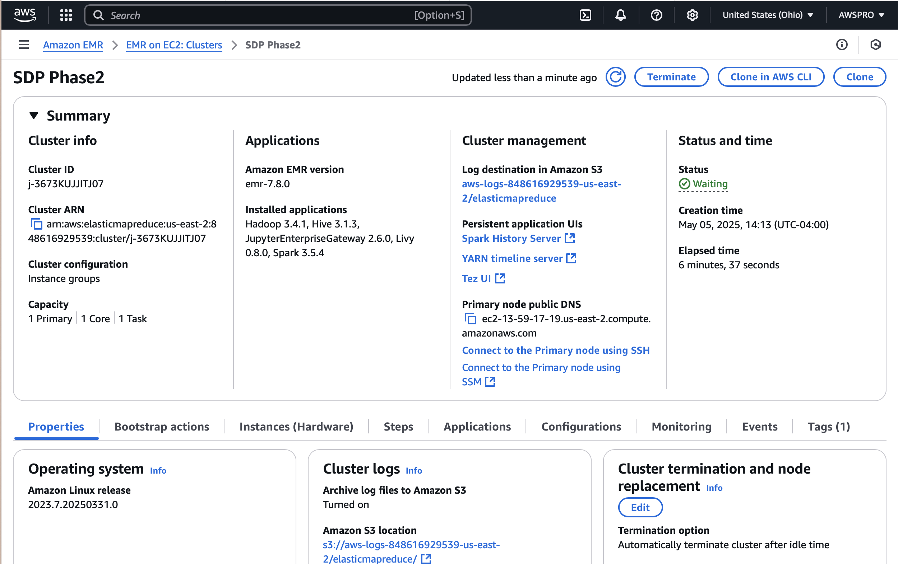
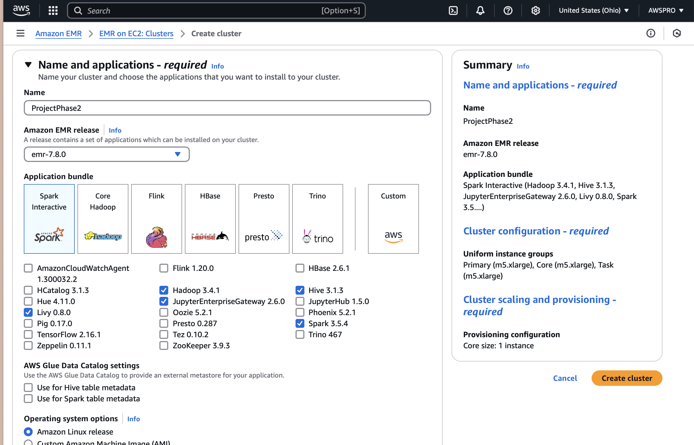
AWS EMR Cluster Setup

Slide 4
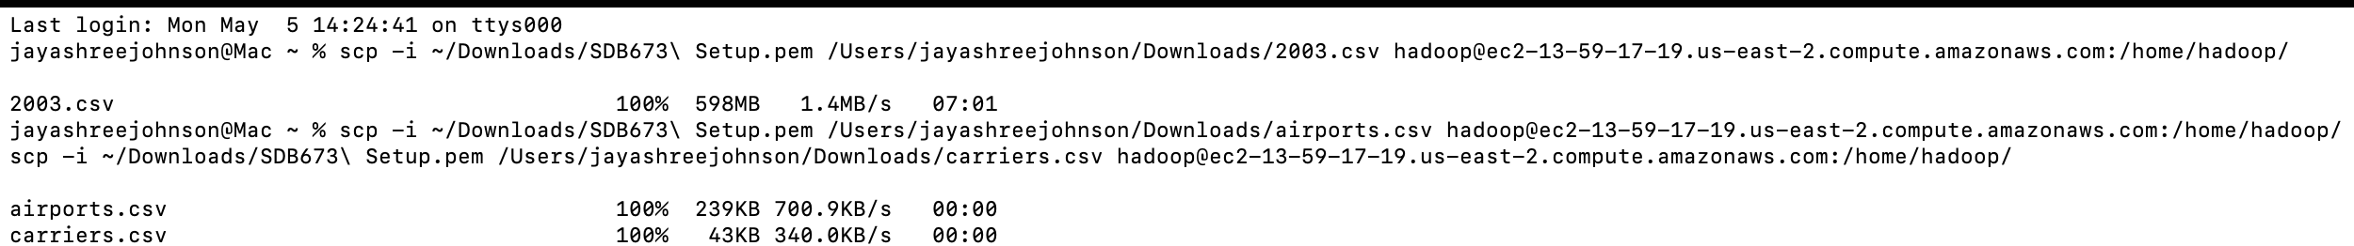
DATA Upload & preparation
scp -i ~/Downloads/SDB673\ Setup.pem /Users/jayashreejohnson/Downloads/2003.csv hadoop@ec2-13-59-17-19.us-east-2.compute.amazonaws.com:/home/hadoop/
scp -i ~/Downloads/SDB673\ Setup.pem /Users/jayashreejohnson/Downloads/airports.csv hadoop@ec2-13-59-17-19.us-east-2.compute.amazonaws.com:/home/hadoop/
scp -i ~/Downloads/SDB673\ Setup.pem /Users/jayashreejohnson/Downloads/carriers.csv hadoop@ec2-13-59-17-19.us-east-2.compute.amazonaws.com:/home/hadoop/

Slide 5
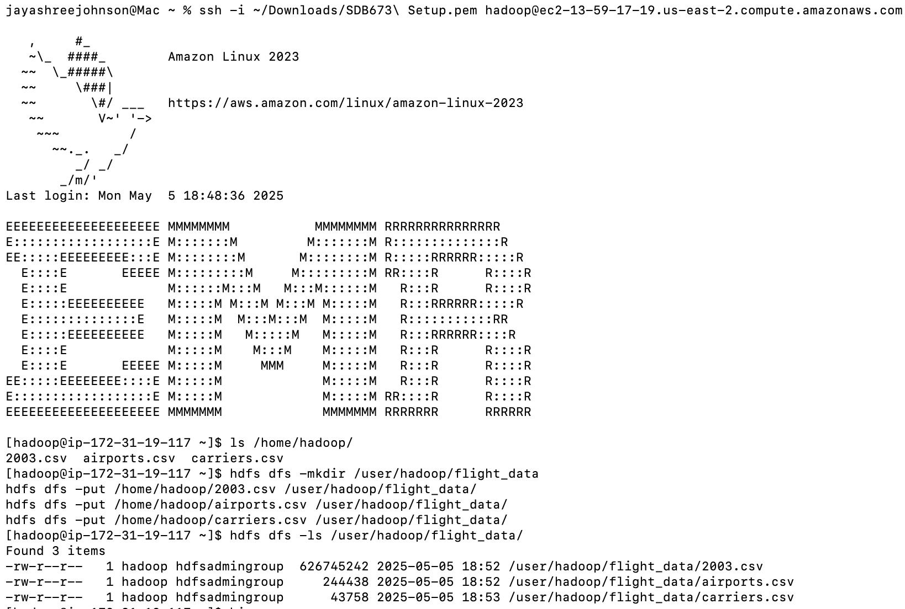
MOVE FILES TO HDFS
hdfs dfs -mkdir /user/hadoop/flight_data
hdfs dfs -put /home/hadoop/2003.csv /user/hadoop/flight_data/
hdfs dfs -put /home/hadoop/airports.csv /user/hadoop/flight_data/
hdfs dfs -put /home/hadoop/carriers.csv /user/hadoop/flight_data/

Slide 6
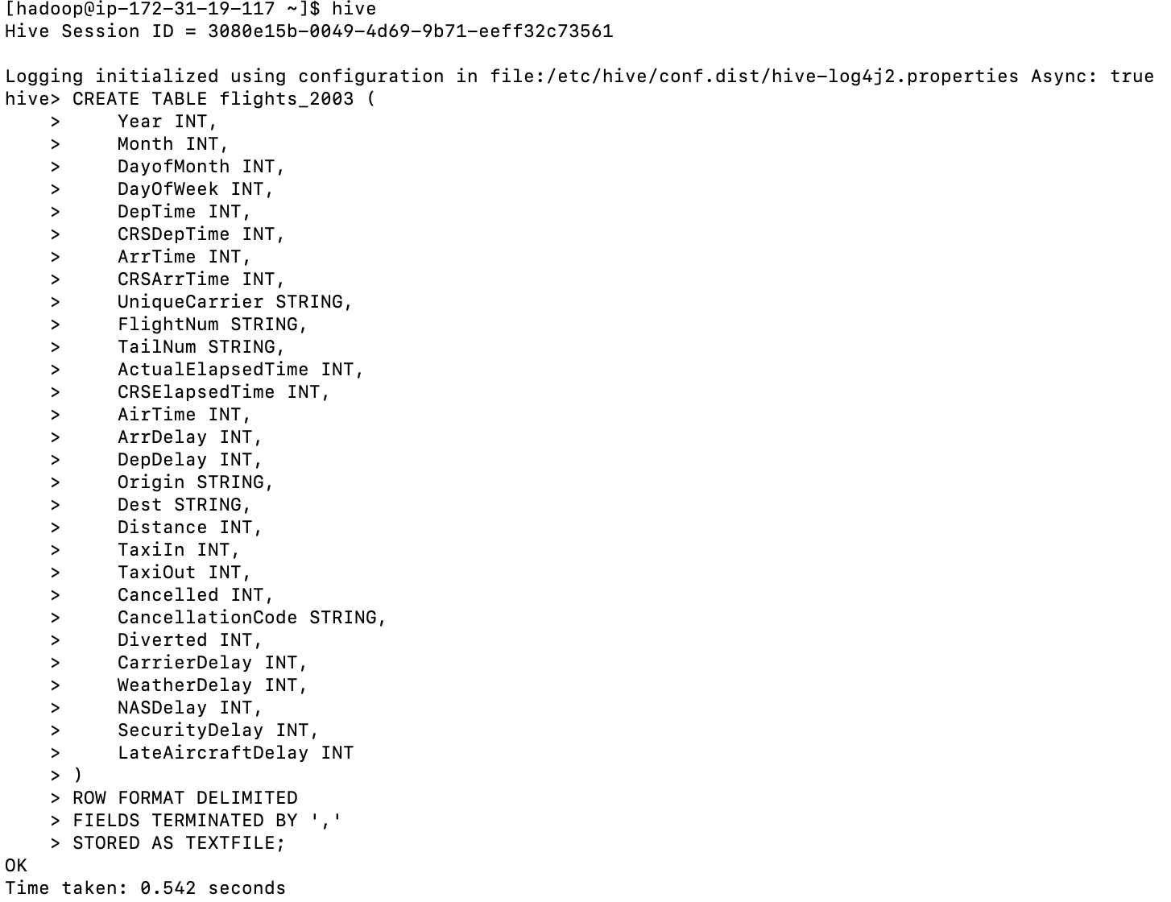
Create Hive Year Table (flights_2003)

Slide 7
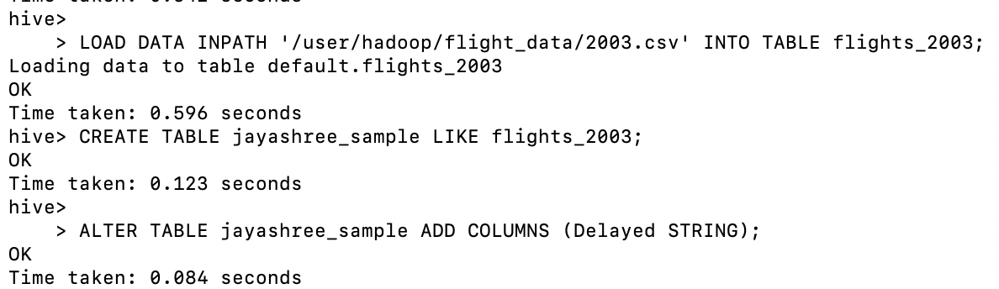
Create Sample Table (jayashree_sample)

Slide 8
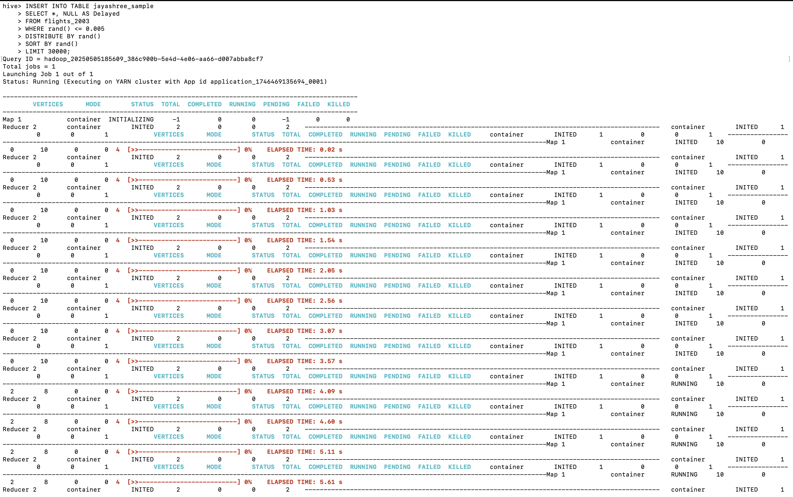
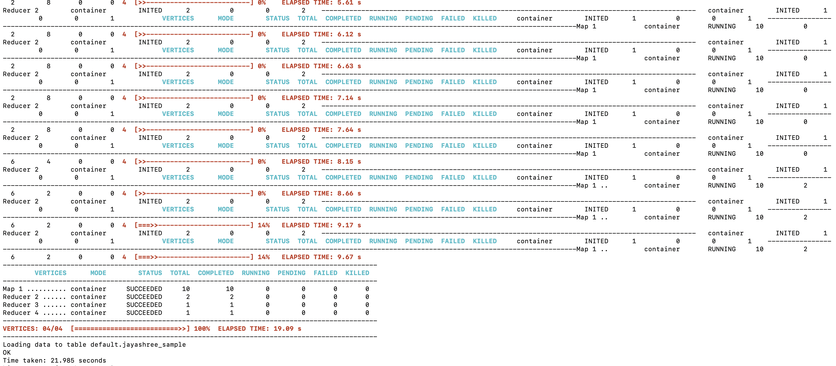
Random Sampling — Select 30,000 Records

Slide 9
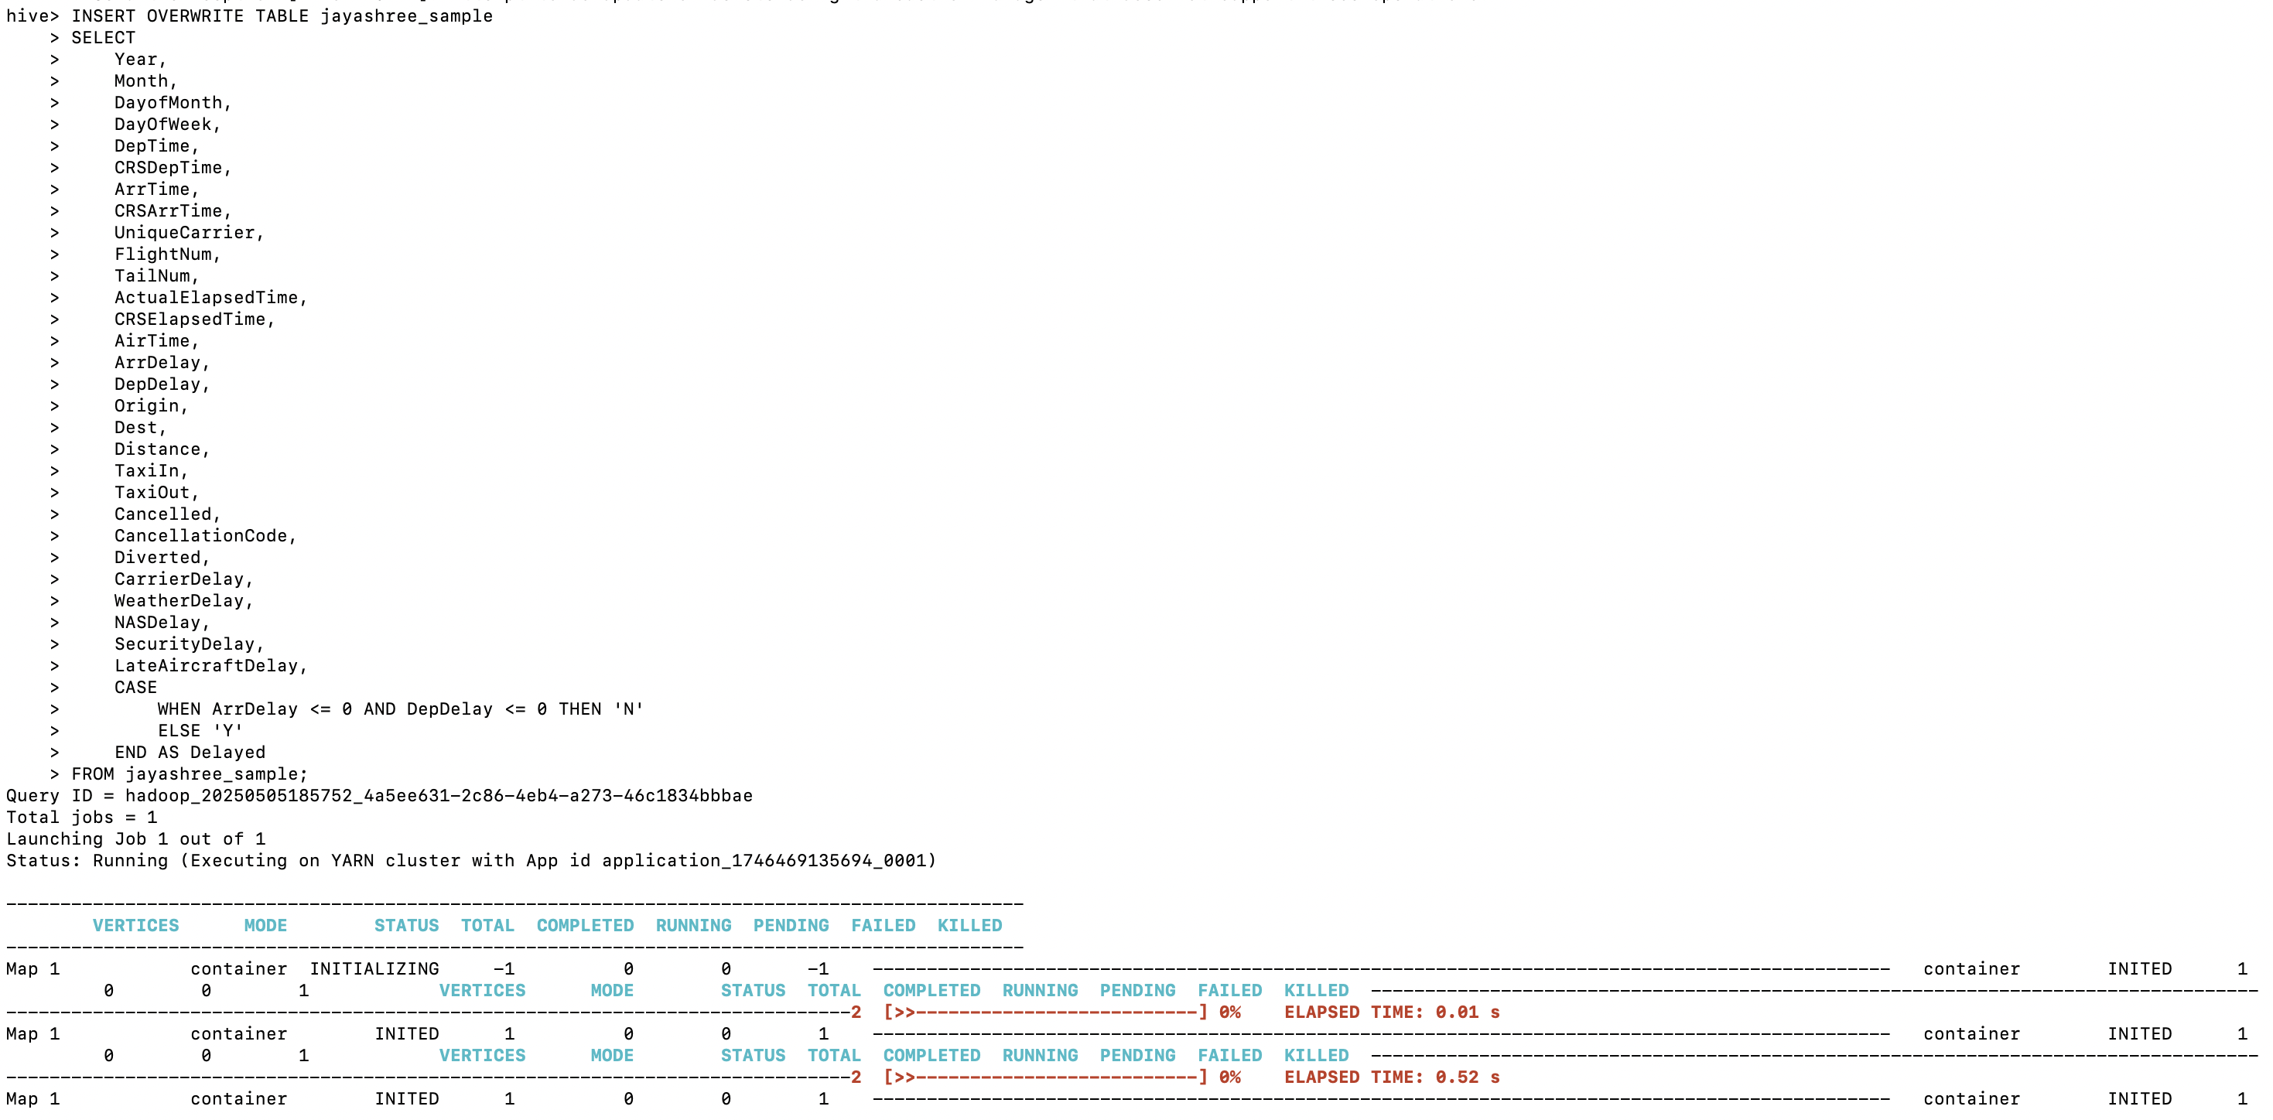
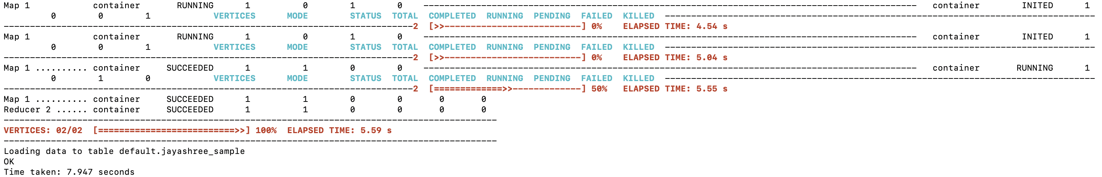
POPULATE THE DELAYED COLUMN

Slide 10
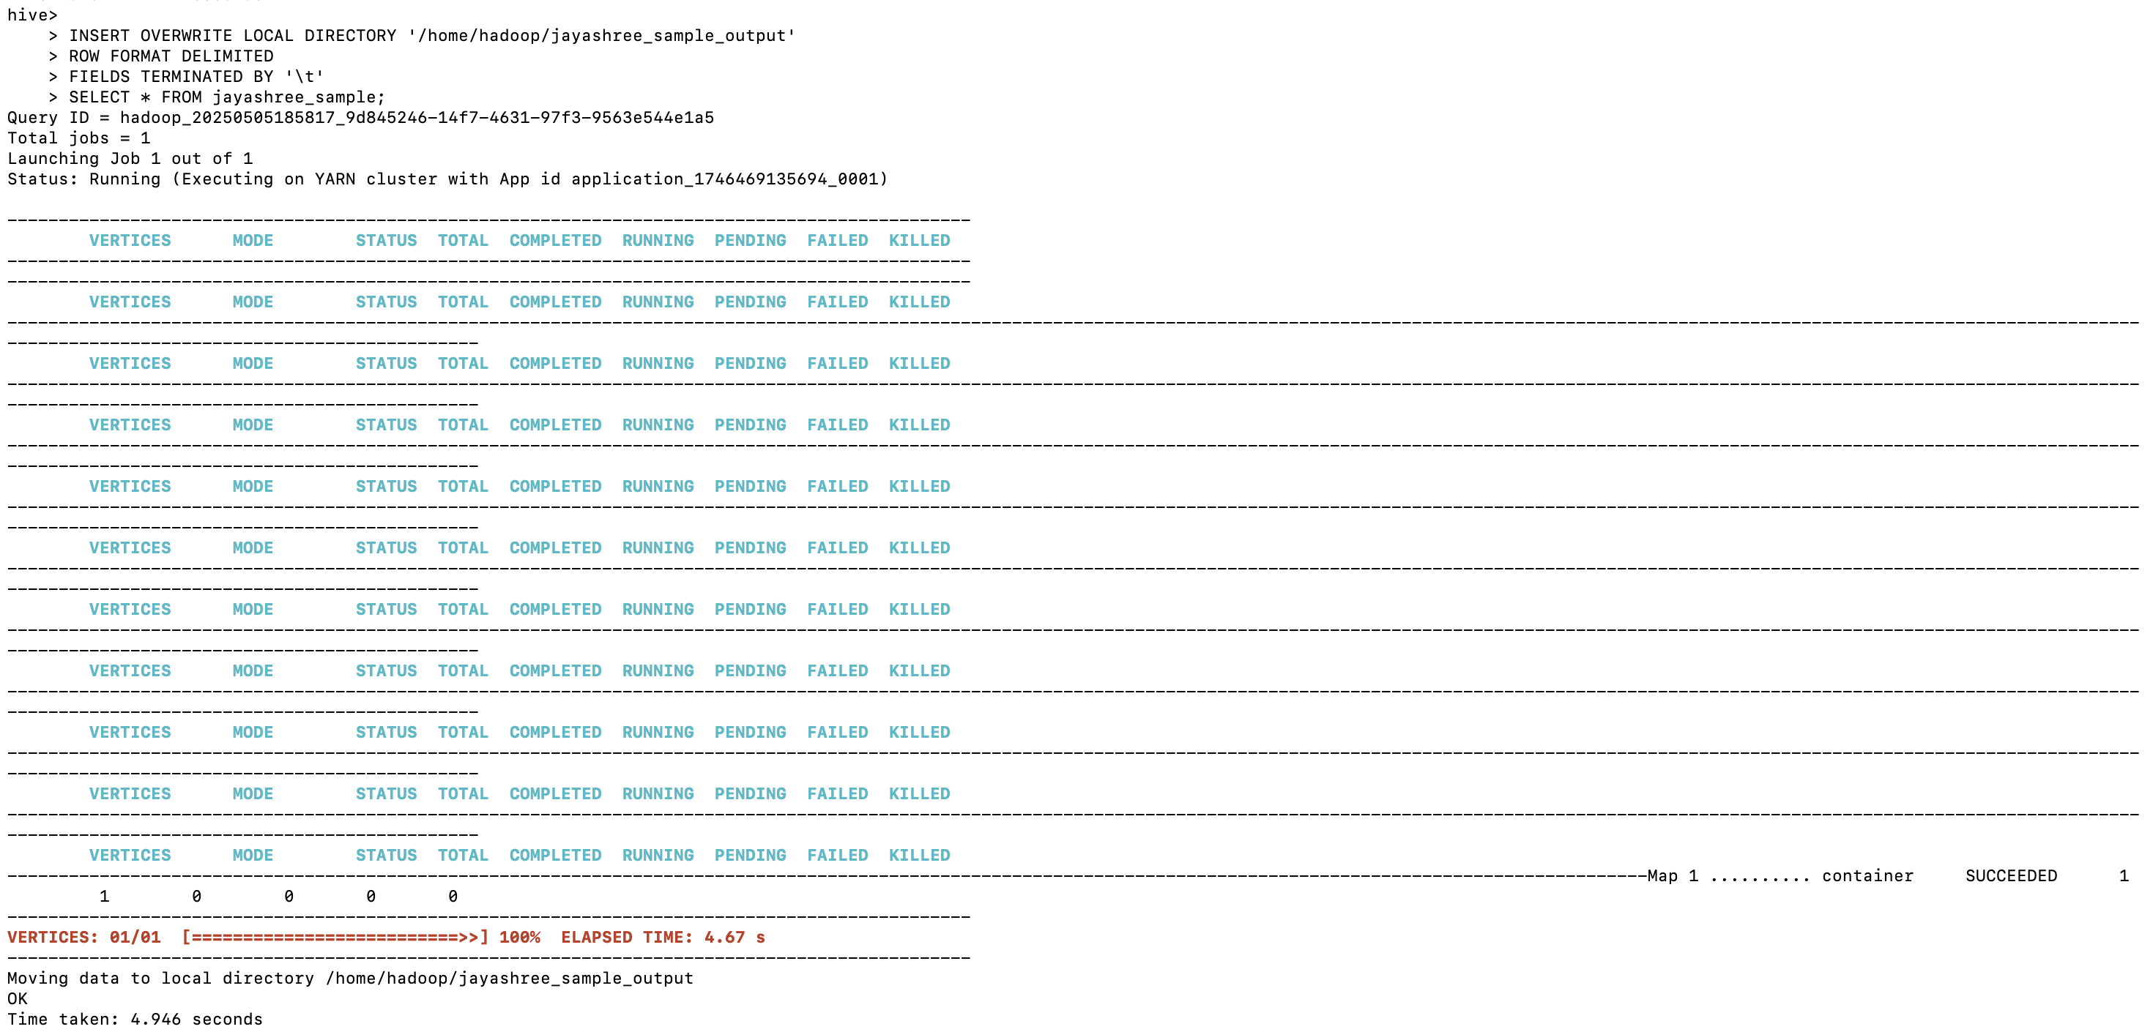
Export Sample Table to Local Directory

Slide 11
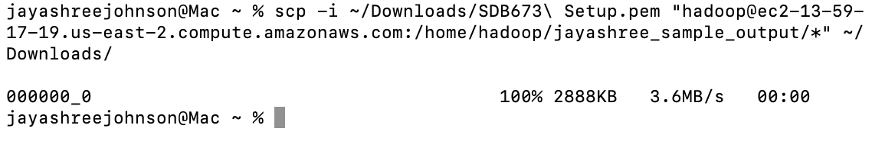

Download Sample to Local Machine

Slide 12
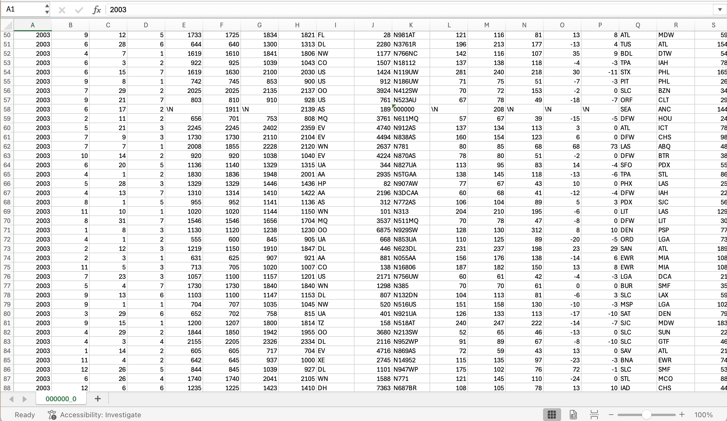
Open Sample Data in Excel

Slide 13
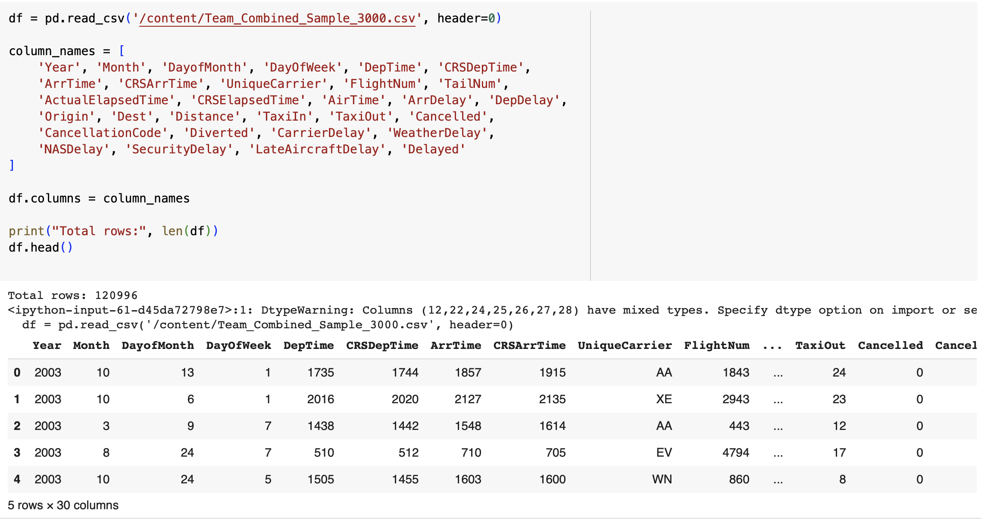
AGGREGATE DATASETS

Slide 14
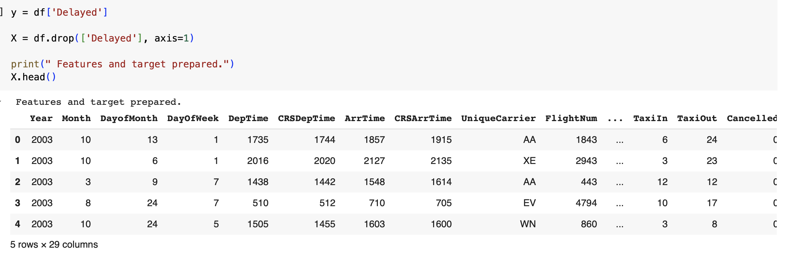
Preparing Features and Target Data for Model Training

Slide 15
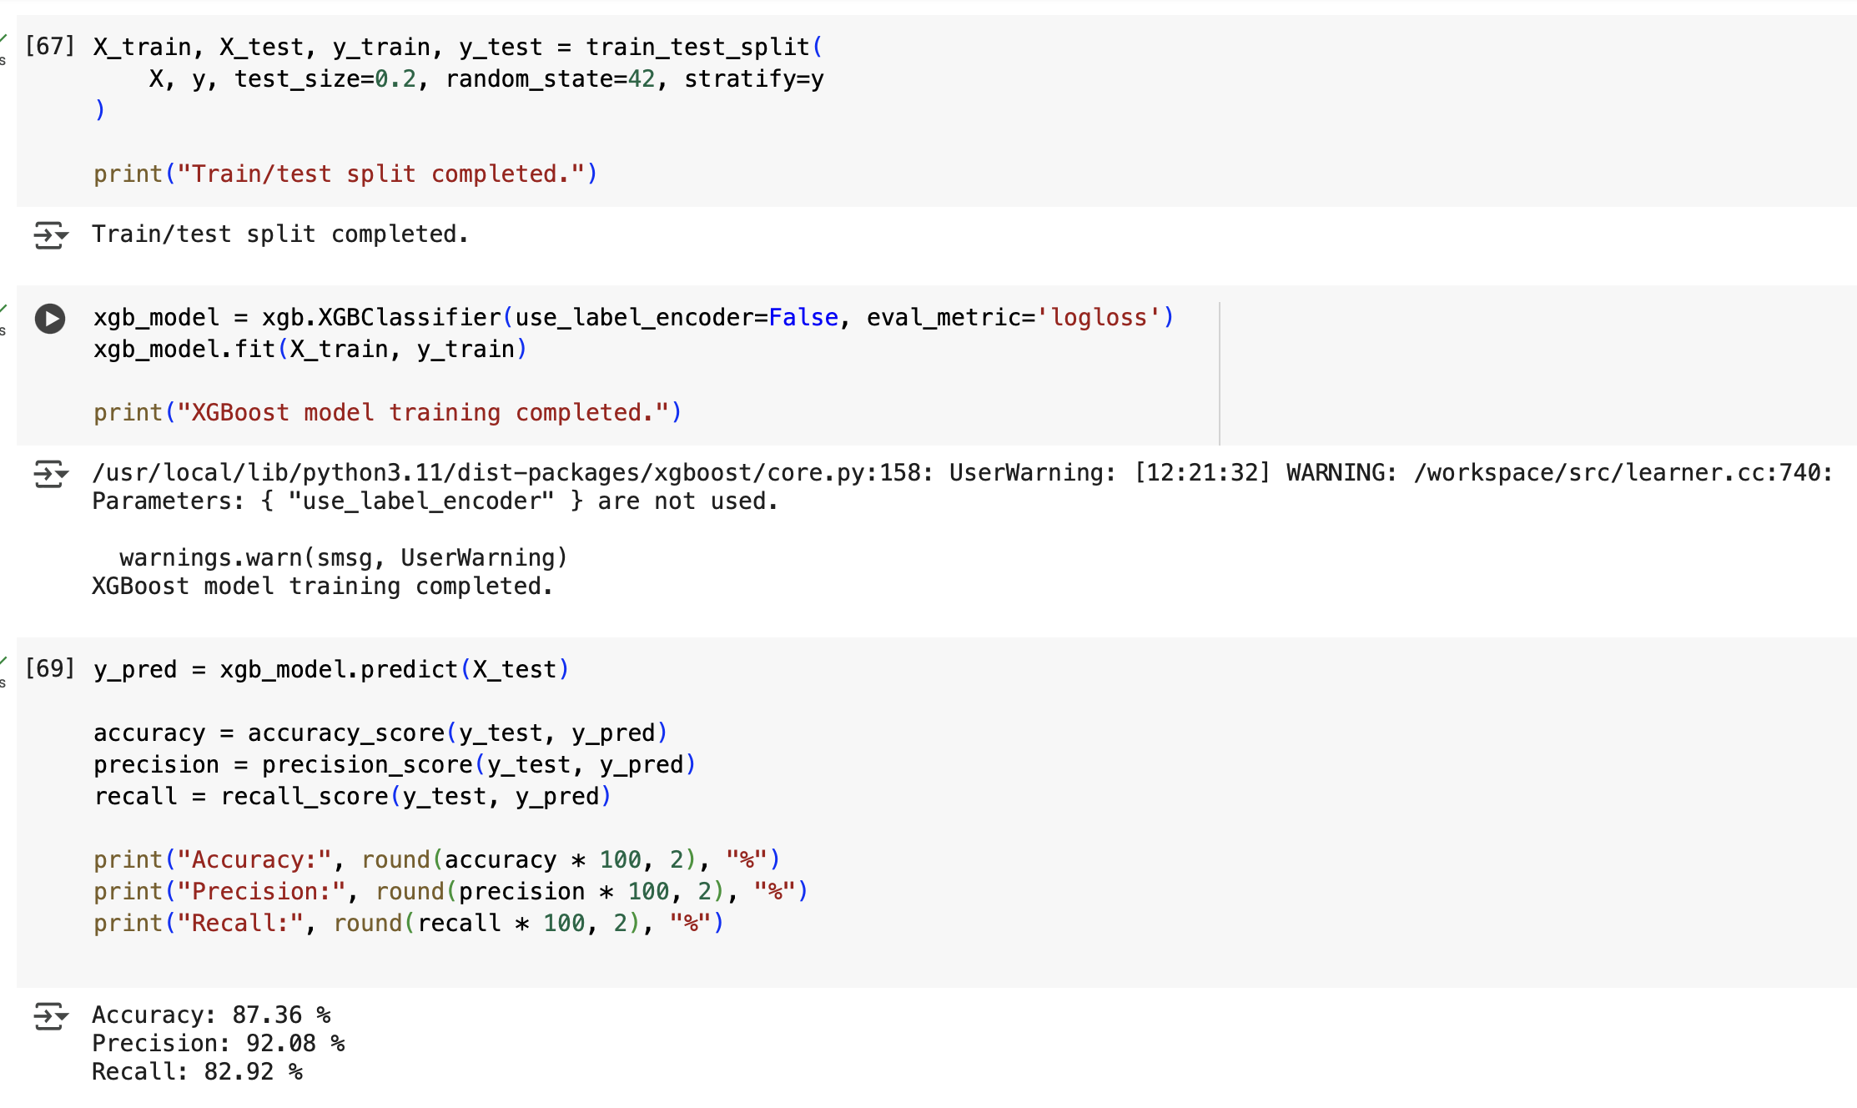
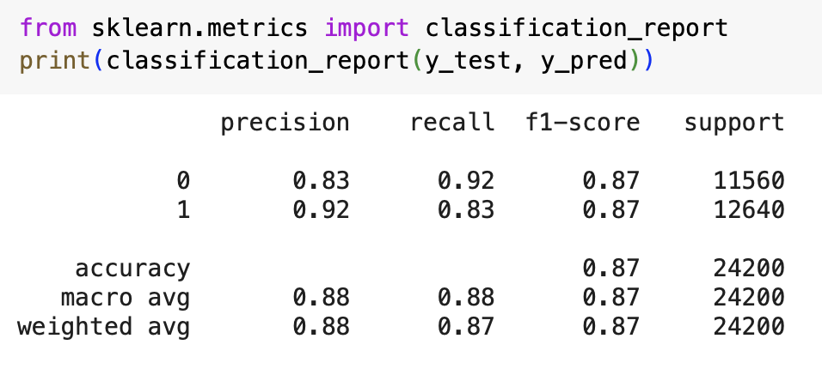
Model Training & Evaluation

Slide 16
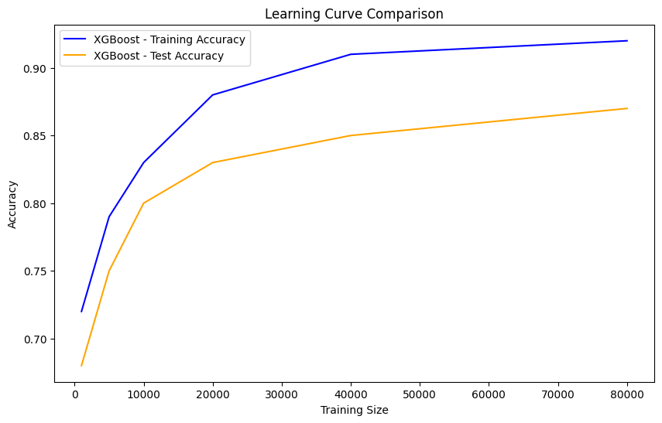

Slide 17
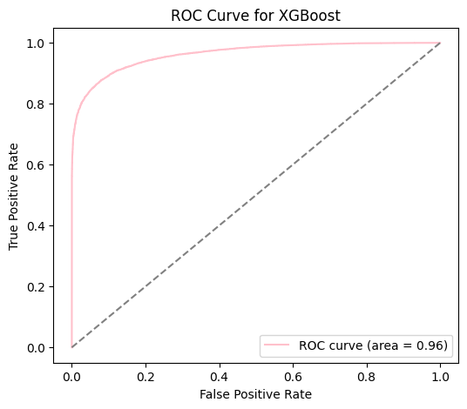
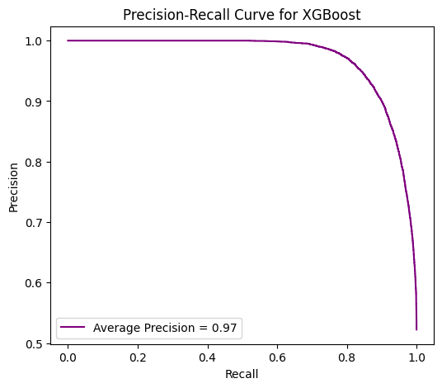

Slide 18
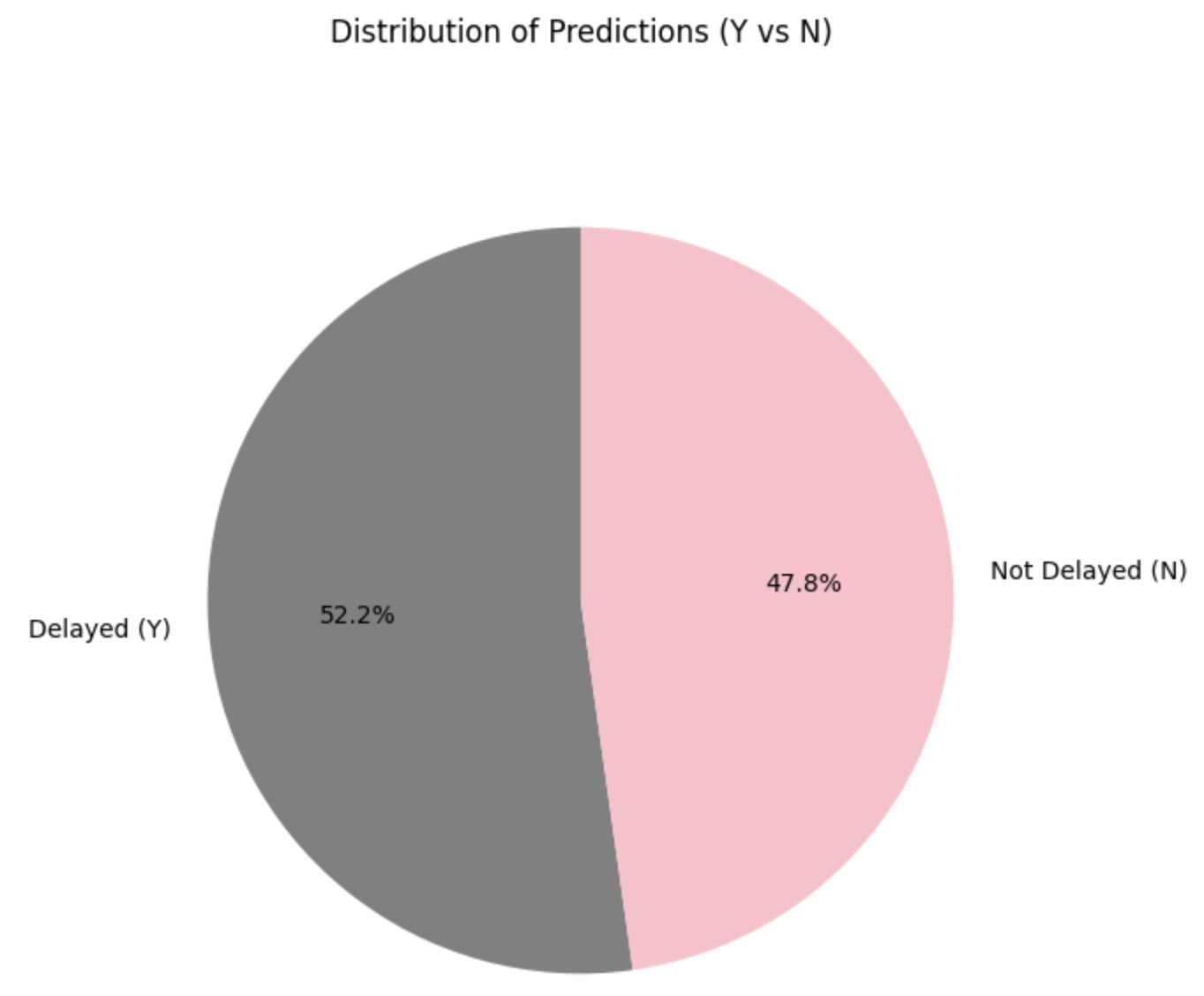

Slide 19
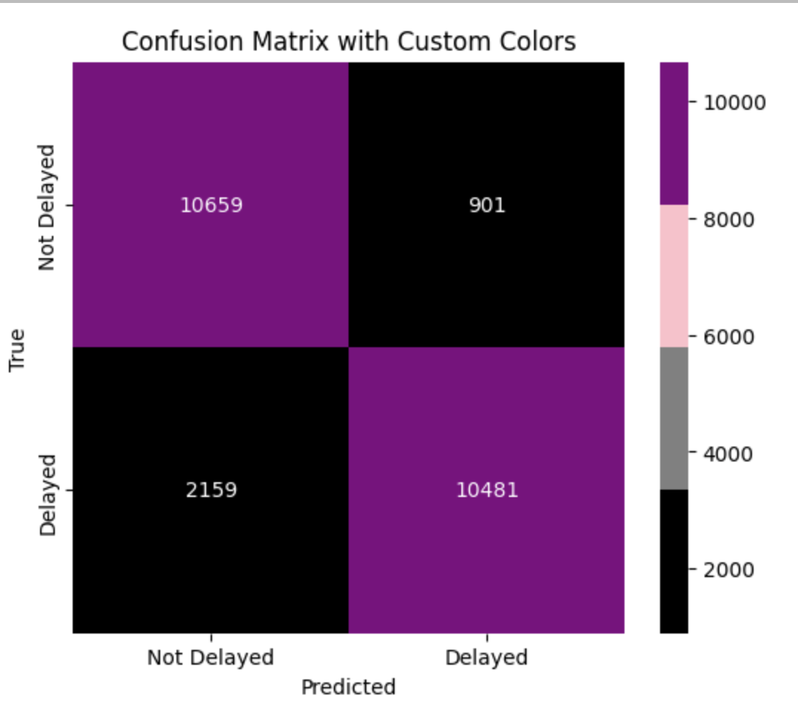

Slide 20
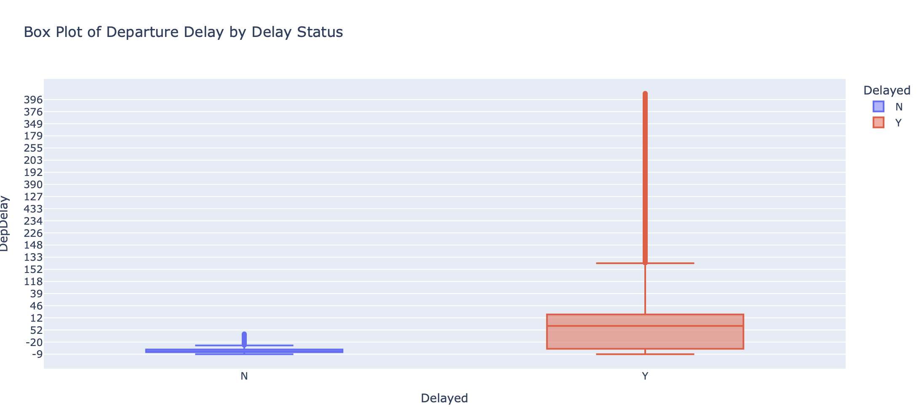

Slide 21
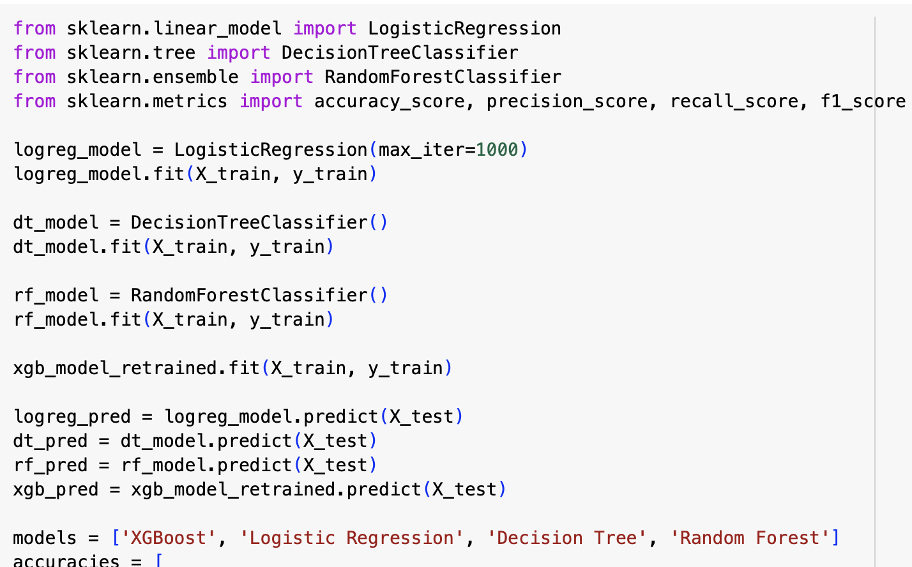
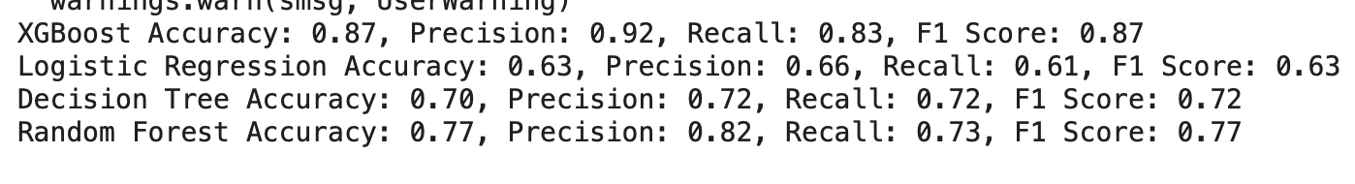
MODEL COMPARISON

Slide 22
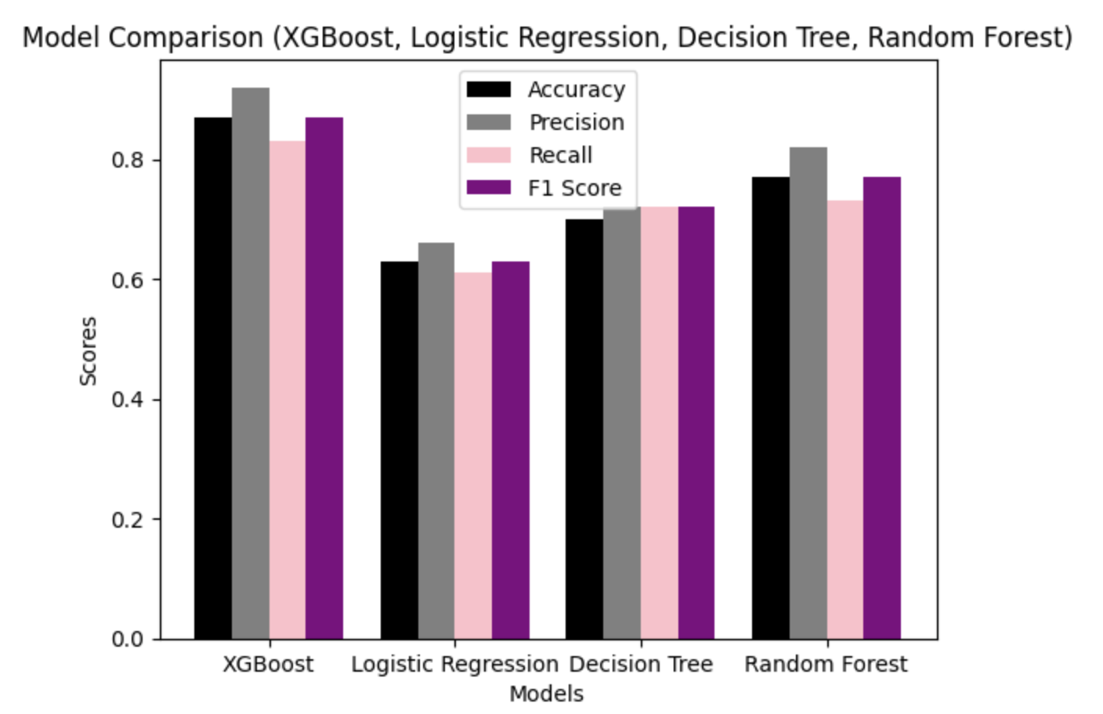

Slide 23
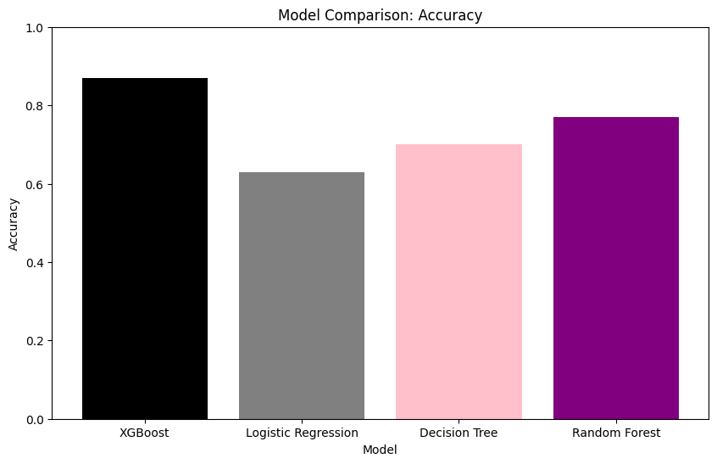

Slide 24
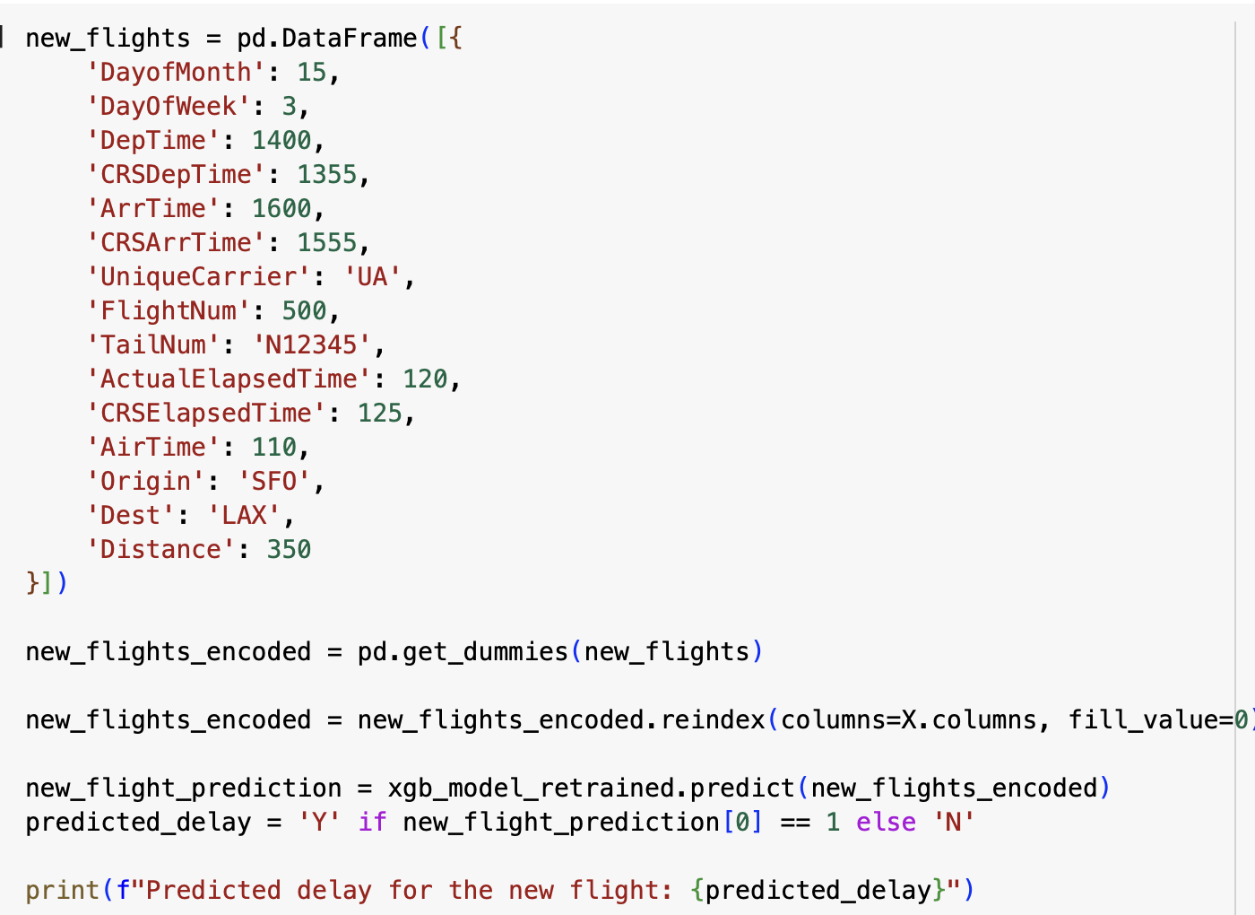
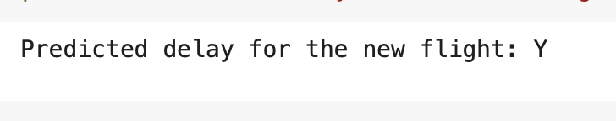
Predicting Delay for New FLIGHT

Slide 25
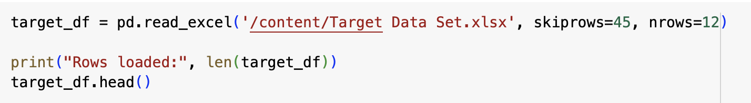
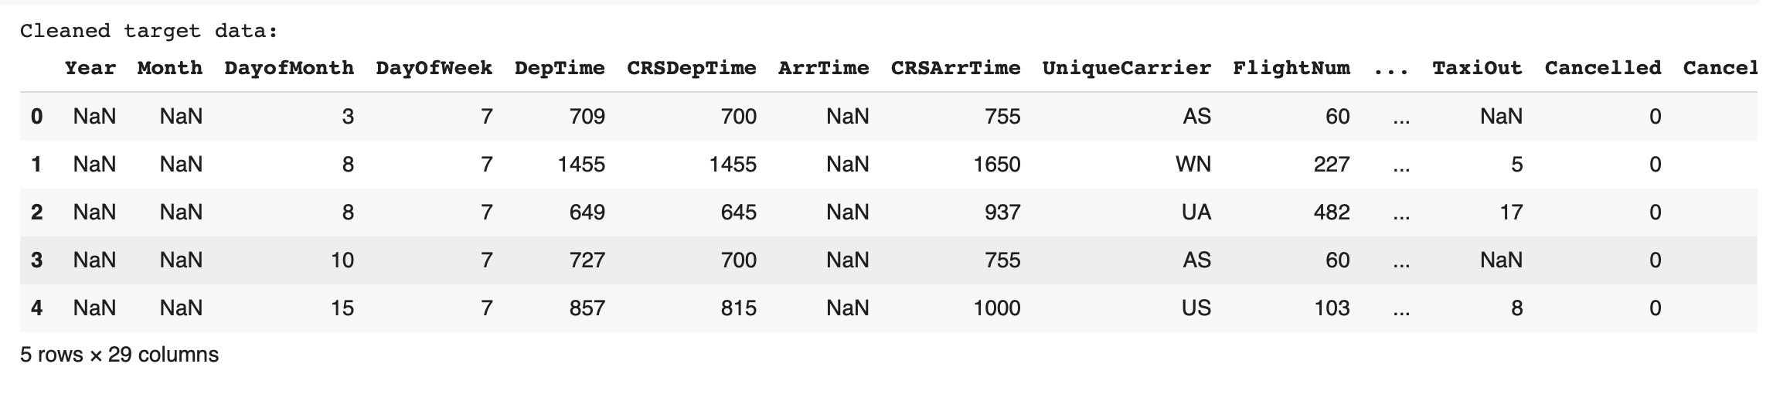
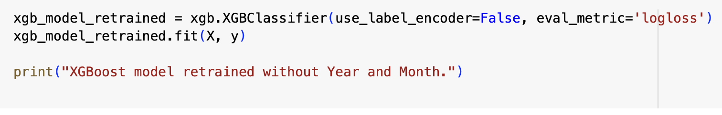
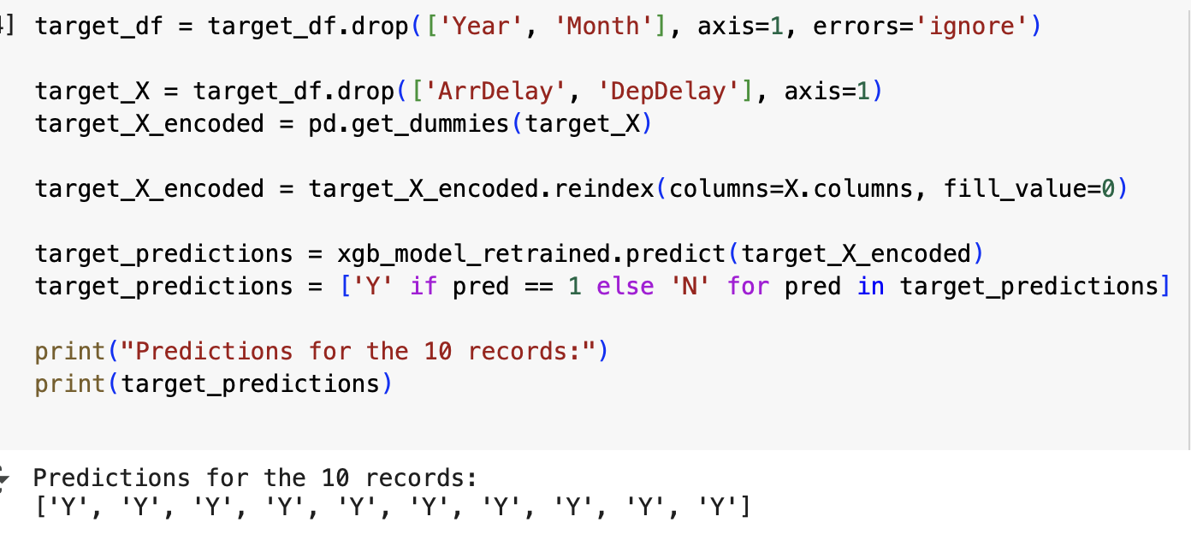
Target Data Predictions

Slide 26
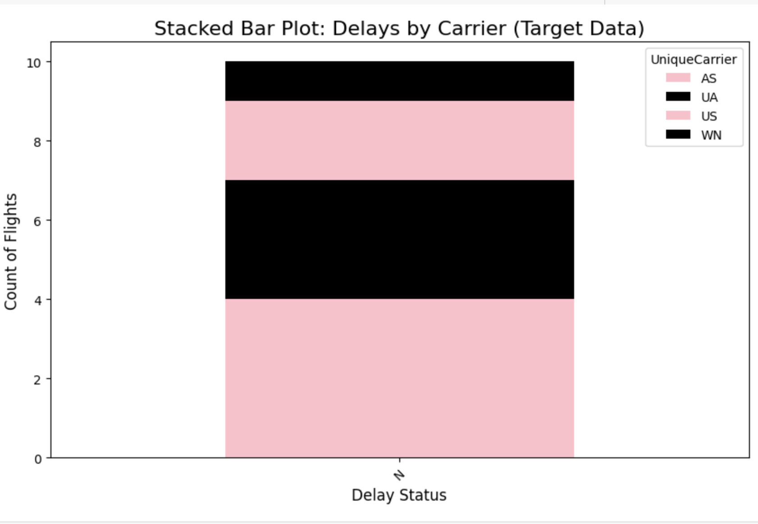

Slide 27
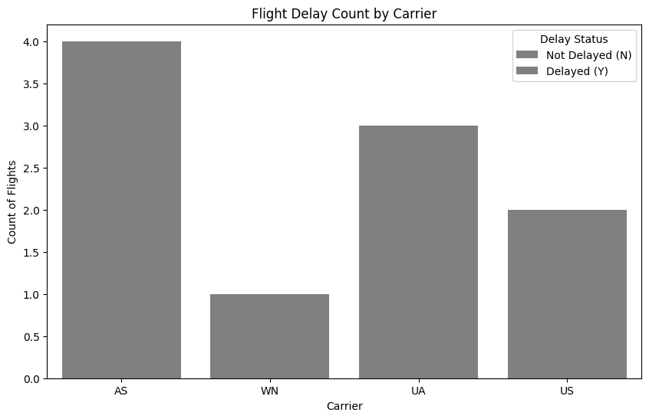

Slide 28
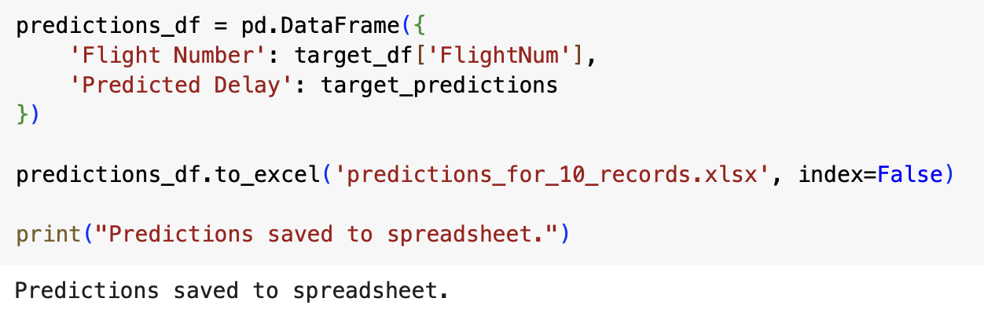
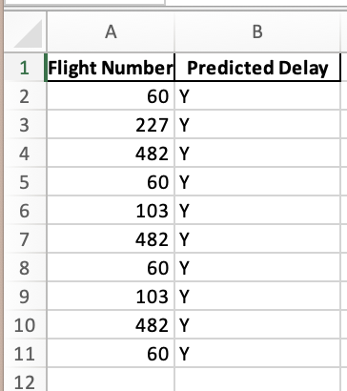
PREDICTION SPREADSHEET

Slide 29
THANK YOU

